Slide 1

The Farmers Market Management App
The Farmers Market Management App simplifies the process of connecting farmers with consumers. This intuitive platform empowers farmers to showcase their products, gain insights into market demand, and optimize their prices for increased revenue.

Slide 2
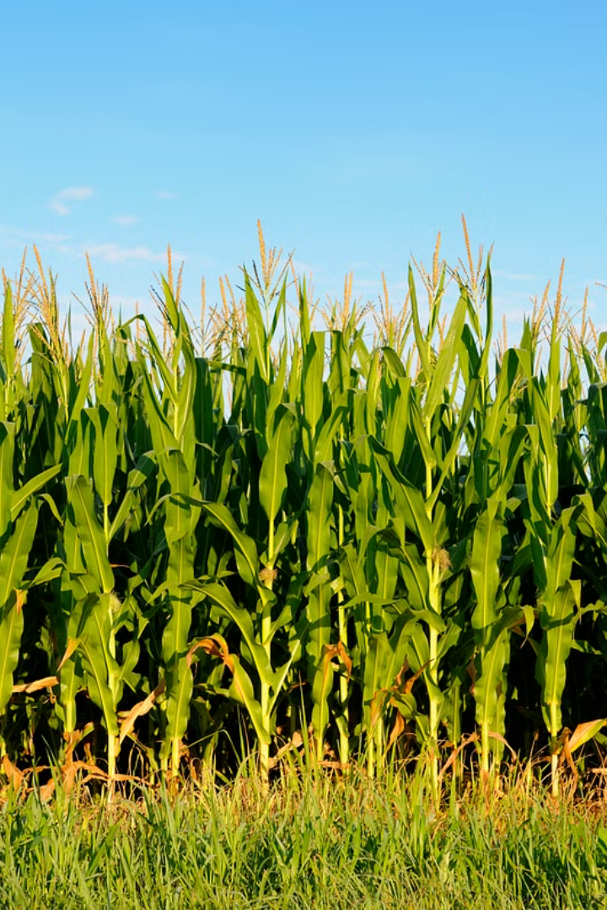
Introduction to the App
User-Friendly Interface
Real-Time Data
Farmers can easily register, list their products, and track their sales with a seamless user experience.
The app provides farmers with real-time data on demand and pricing trends. This data helps them make informed decisions about their operations.
Improved Communication
The app facilitates communication between farmers and consumers, allowing for efficient transactions and feedback.

Slide 3
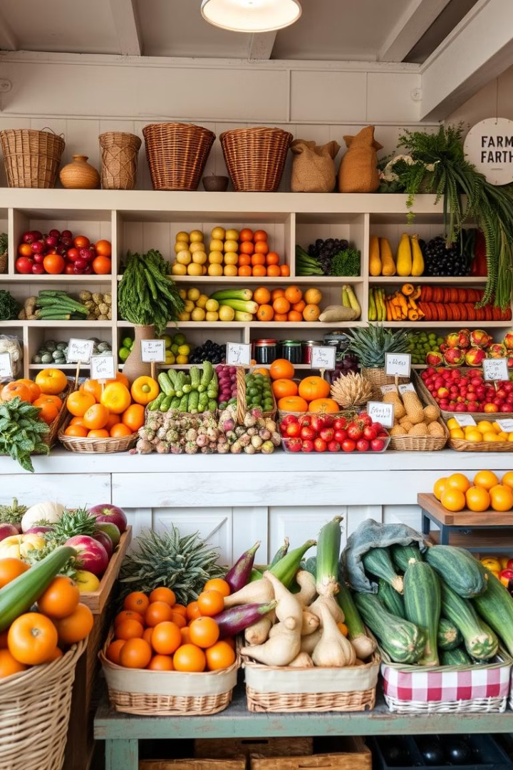

Key Features
1
Product Listing
2
Order Management
Farmers can easily list their products, including detailed descriptions, photos, and pricing information.
Farmers can manage orders efficiently, track delivery status, and ensure timely fulfillment.
3
Payment Processing
The app facilitates secure online payments for convenient and safe transactions.

Slide 4
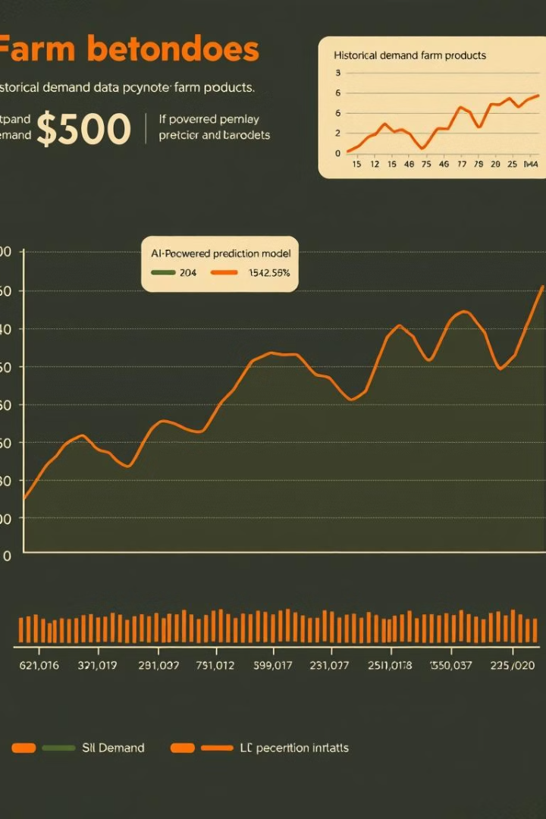
AI-Powered Demand Forecasting
1
Historical Data Analysis
The app analyzes historical sales data to understand trends in demand for specific products.
2
Predictive Modeling
AI algorithms predict future demand based on historical data and market factors.
3
Demand Score
The app provides farmers with a real-time demand score for each product, helping them understand market interest.

Slide 5
Dynamic Pricing Recommendations
Data-Driven Pricing
Optimal Pricing
Market Fluctuation
The app utilizes real-time demand data and AI algorithms to generate dynamic pricing recommendations.
Farmers can adjust their prices based on the recommendations to optimize revenue and meet market demand.
Dynamic pricing allows farmers to adapt to changing market conditions and ensure competitive pricing.

Slide 6



Enhancing Market Access for Farmers
Expanded Reach
Local Market Access
Reduced Costs
The app helps farmers reach a wider audience by connecting them with consumers in various locations.
The app simplifies access to local farmers markets for consumers, making it easier to find fresh, locally sourced products.
The app eliminates the need for traditional intermediaries, reducing costs for both farmers and consumers.

Slide 7





Benefits for Consumers
Fresh, Local Produce
Supporting Local Farmers
Consumers can access fresh, locally grown produce directly from farmers.
The app helps consumers support local farmers and contribute to their communities.
Competitive Pricing
Sustainability
Consumers benefit from competitive pricing and can avoid inflated costs.
The app promotes sustainable agricultural practices and reduces food waste.

Slide 8

Easy to Use Interface
The app is designed for ease of use. The user interface is intuitive and straightforward, making it simple for both farmers and consumers to navigate.
Users can quickly find the information they need and complete tasks such as browsing products, placing orders, and tracking deliveries with minimal effort.

Slide 9
Product Browsing and Purchasing
Consumers can browse available products.
Informed purchases support local agriculture.
The app promotes fair pricing.
Easy access to fresh, locally sourced products.

Slide 10

Conclusion and Next Steps
The Farmers Market Management App is transforming the way farmers and consumers interact.
This innovative platform is revolutionizing the food supply chain, offering numerous benefits for both parties.
Future development will focus on integrating new features and expanding the app's reach to further empower farmers and consumers.

